Slide 1
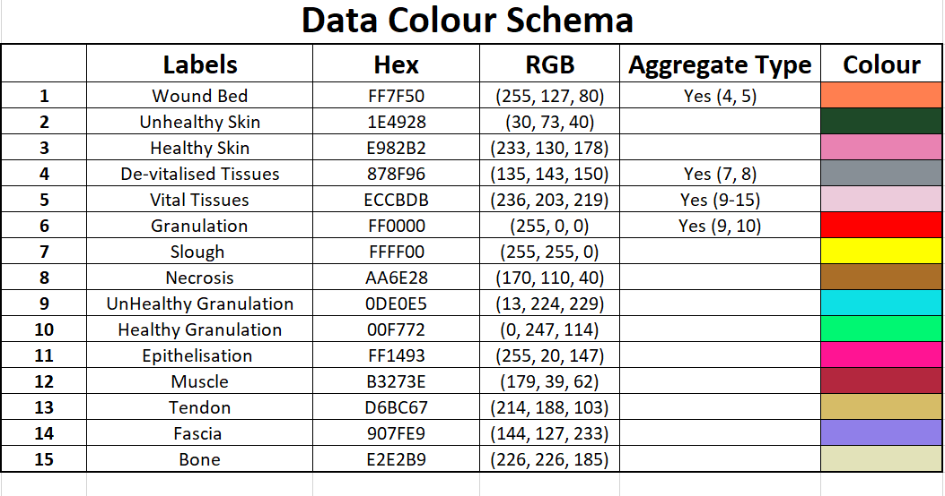

Slide 2
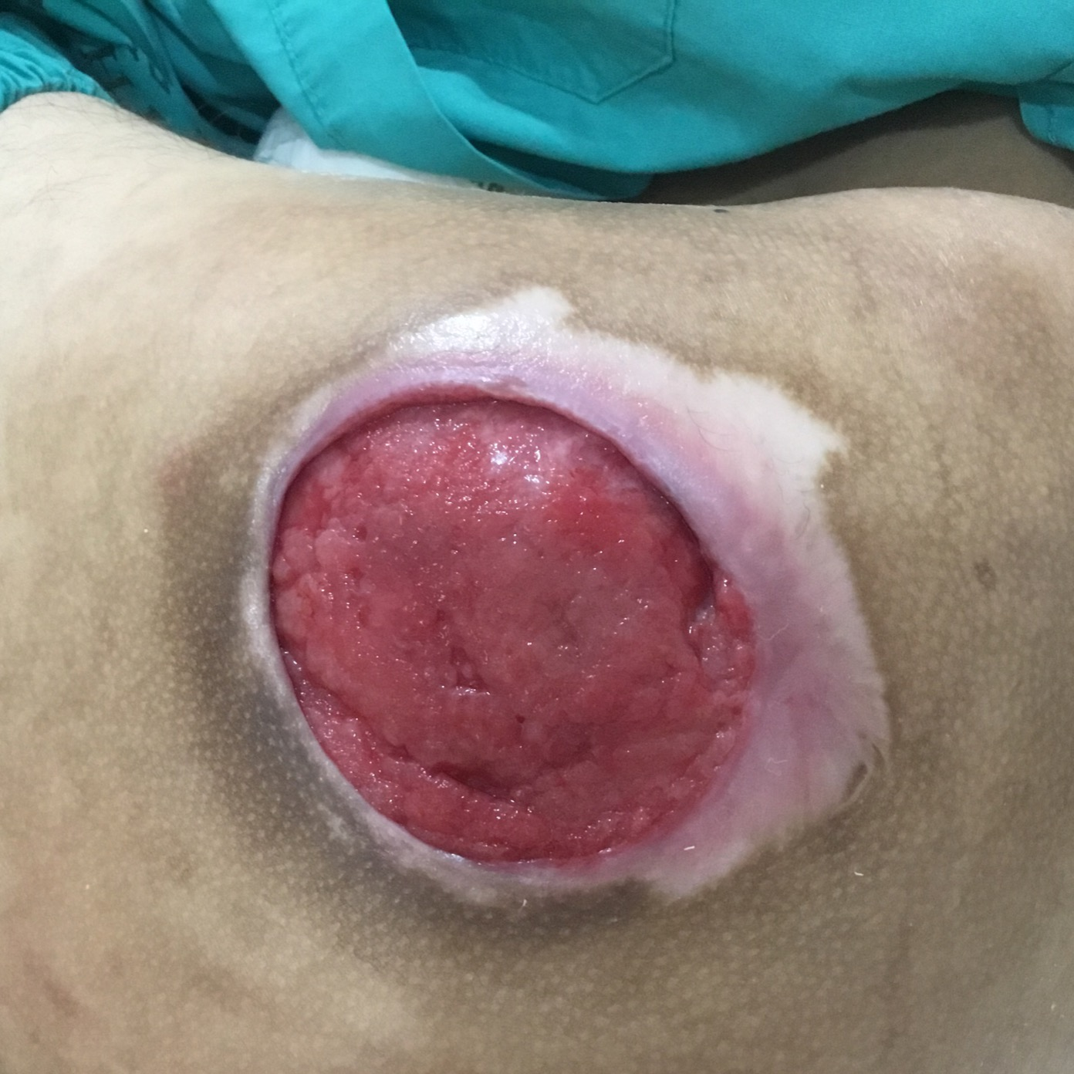
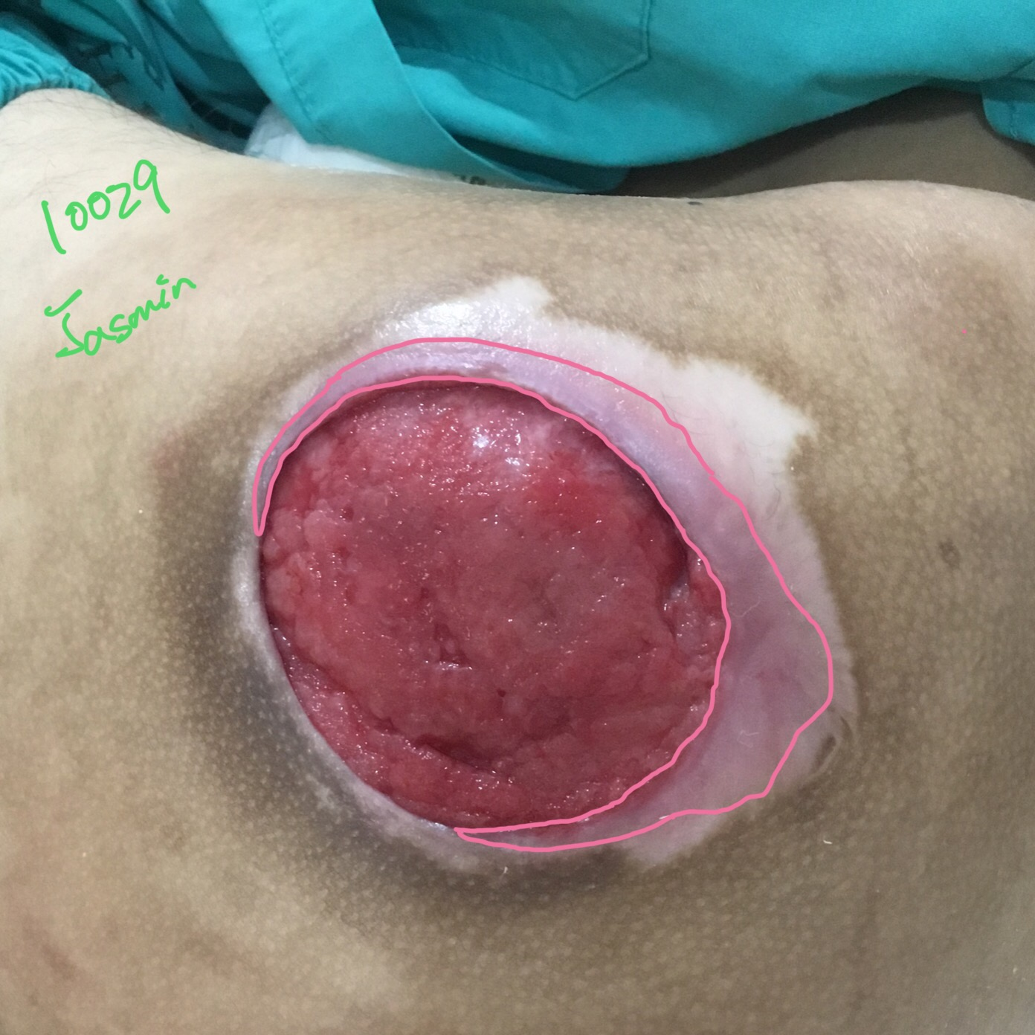
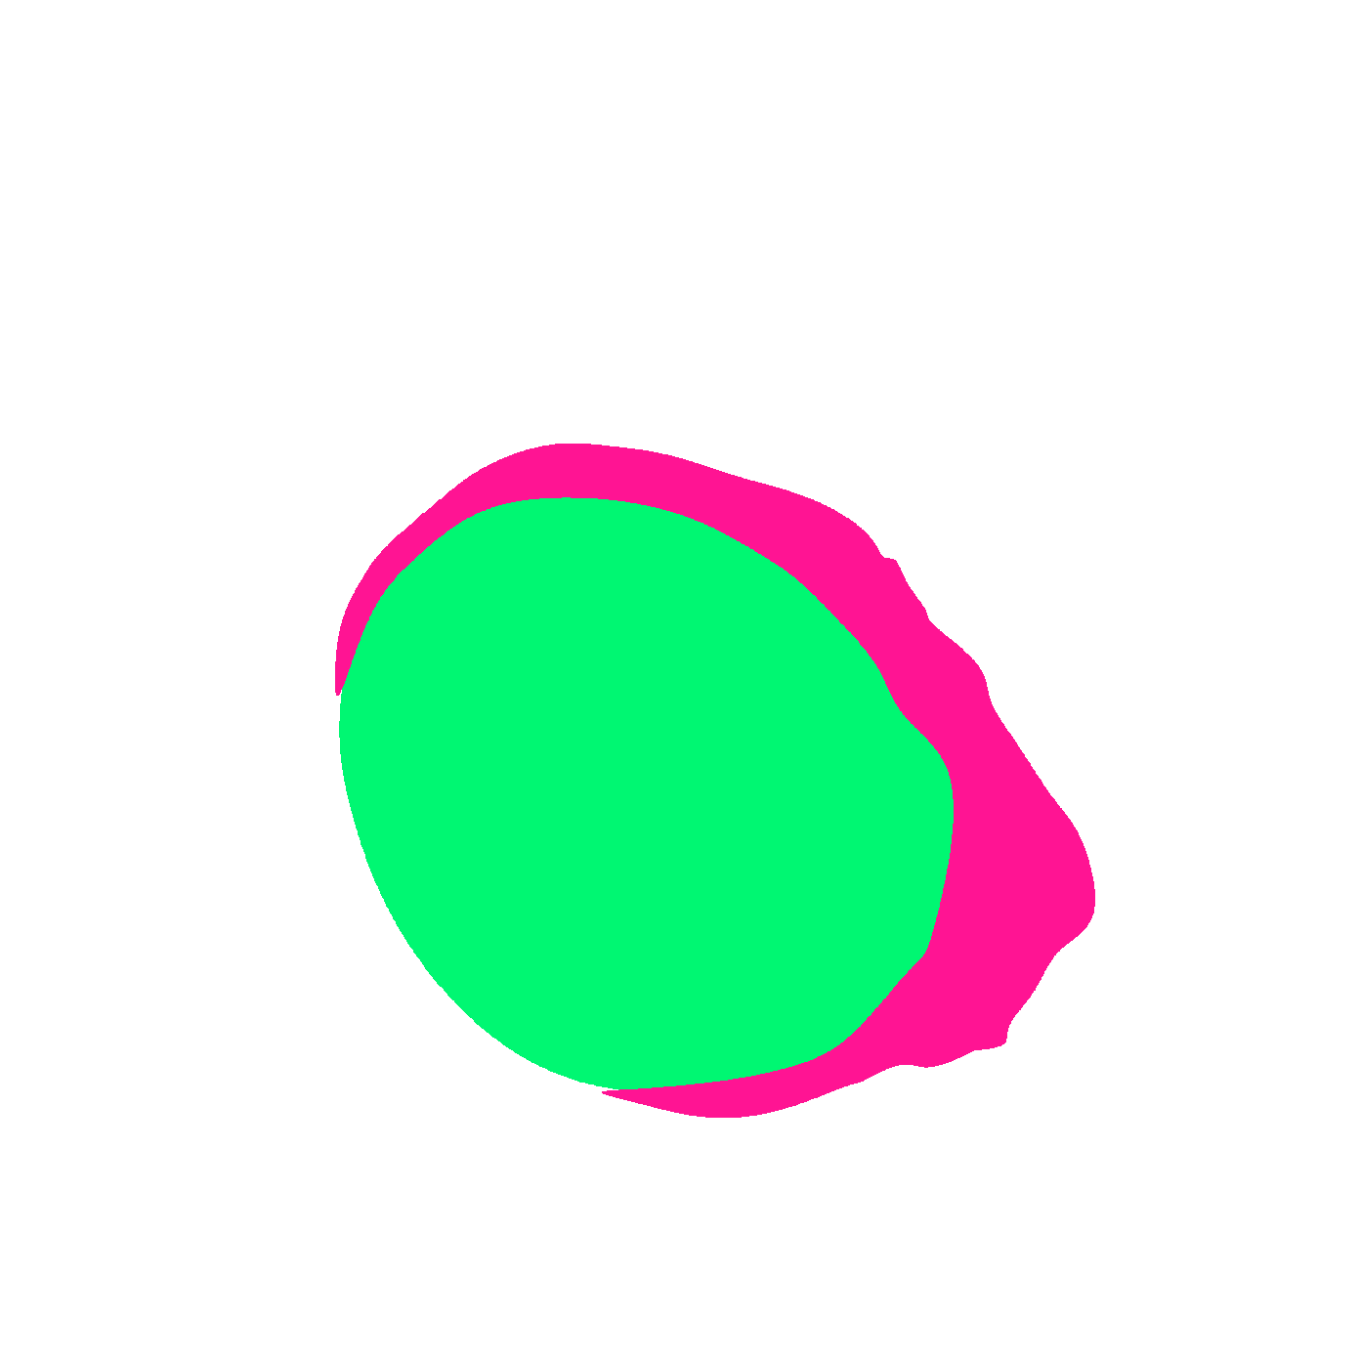
Original Wound Img
Latest Annotation
Original Mask
Metadata Wound Location: Wound Type:

Slide 3

epithelizing/healthy skin?
Notes:
black line distinction between epithelizing and normal skin - very slight difference in the texture and density.

Slide 4

Original Wound Img
New Mask
Original Mask

Slide 5
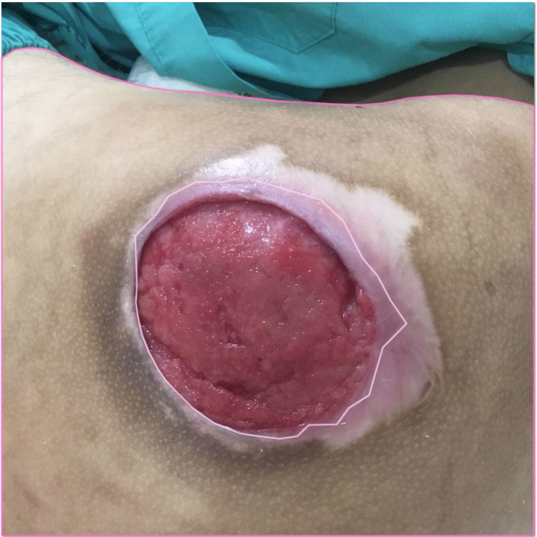

Slide 6

SD: Check the edges
JX: Accepted

Slide 7


Slide 8
